Slide 1
HR ANALYTICS DASHBOARD
CONCLUSION
ADVANCEMENTS
DASHBOARD
DASHBOARD
DATASET
INTRODUCTION
USING POWER BI
Presented by:
GROUP - 01
Akanksha Nalla
Kavya Nalamothu
Divya Kumar
Karan Bharale
Chiranjeevi

Slide 2


Power BI is a powerful business analytics tool by Microsoft that enables users to visualize data, create interactive dashboards, and generate insights. It simplifies data analysis and sharing, empowering better decision-making across organizations. And Excel is used for initial data cleaning and preparation.
HR analytics uses data and statistical methods to gain insights into workforce trends, improving decision-making in human resource management.
This HR Analytics Dashboard is designed to provide comprehensive insights into employee attrition patterns within an organization.
CONCLUSION
INTRODUCTION
ADVANCEMENTS
DASHBOARD
DASHBOARD
DATASET

Slide 3
The dataset contains 1,470 rows and 38 columns, covering detailed employee information. Here's an overview of its key features:
Key Columns:
Attrition: Indicates if the employee has left the company (Yes or No).
BusinessTravel: Frequency of business travel.
Department: Department of the employee.
AgeGroup, AttritionLabel, AttritionCount: Categorical groupings for age and attrition-related analysis.
EducationField, JobRole, MaritalStatus, Gender: Employee demographics.
PerformanceRating, JobSatisfaction, WorkLifeBalance, EnvironmentSatisfaction: Employee feedback on their job.
MonthlyIncome, TotalWorkingYears, YearsAtCompany: Work and compensation metrics.
Numeric Variables: Metrics like Age, DailyRate, MonthlyRate, DistanceFromHome, and TrainingTimesLastYear offer quantitative insight.
Target Variable:
Attrition is the focus, capturing employee churn.
CONCLUSION
INTRODUCTION
ADVANCEMENTS
DASHBOARD
DASHBOARD
DATASET

Slide 4
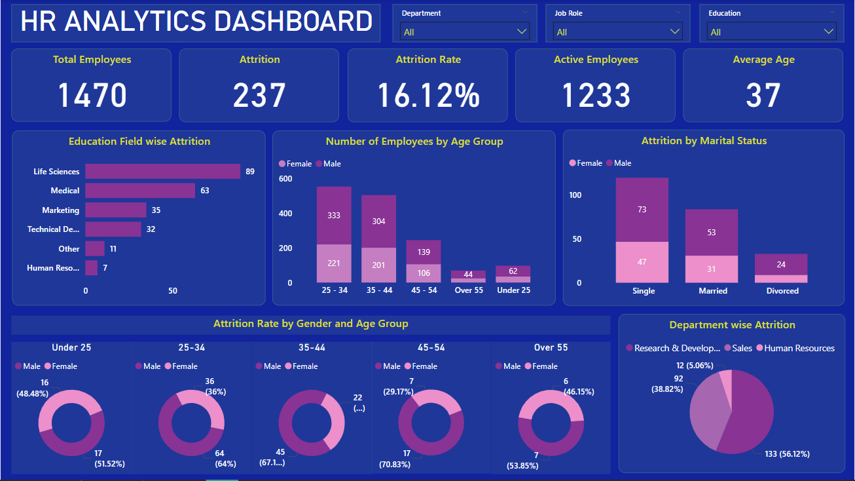
CONCLUSION
INTRODUCTION
ADVANCEMENTS
DASHBOARD
DASHBOARD
DATASET

Slide 5
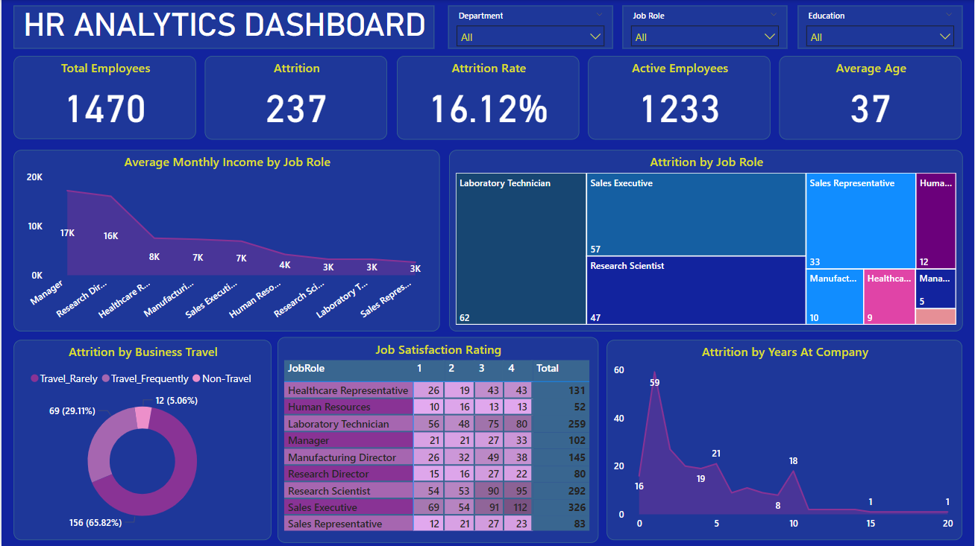
CONCLUSION
INTRODUCTION
ADVANCEMENTS
DASHBOARD
DASHBOARD
DATASET

Slide 6
Attrition Strategies:
Conduct surveys or interviews to identify factors causing attrition.
Develop strategies for Laboratory Technicians like career development, skills training, and mentorship programs.
Offer flexible work, career development programs, and work-life balance initiatives for 25 - 34 year olds or singles.
Provide comprehensive onboarding, mentorship, and regular feedback for new employees to reduce early attrition.
Future Advancements:
Broaden HR Metrics: Include additional HR areas such as:
Employee Productivity.
Recruitment Effectiveness (time-to-hire, quality of hire).
Employee Engagement and Morale trends.
Diversity and Inclusion metrics.
Include Cost Analysis: Calculate the cost of attrition, including:
Recruitment costs.
Training costs for new employees.
Productivity losses.
CONCLUSION
ADVANCEMENTS
INTRODUCTION
DASHBOARD
DASHBOARD
DATASET

Slide 7
This HR Analytics Dashboard serves as a critical tool for HR managers, enabling them to:
Identify patterns of employee attrition by department, role, and demographics.
Understand the impact of factors like job satisfaction, income, and business travel on retention.
Develop data-driven strategies to improve employee engagement, retention, and workforce management.
By leveraging the insights provided, HR teams can address key challenges, optimize employee satisfaction, and strengthen organizational performance.
CONCLUSION
INTRODUCTION
ADVANCEMENTS
DASHBOARD
DASHBOARD
DATASET
THANK YOU

Slide 8
This HR Analytics Dashboard serves as a critical tool for HR managers, enabling them to:
Identify patterns of employee attrition by department, role, and demographics.
Understand the impact of factors like job satisfaction, income, and business travel on retention.
Develop data-driven strategies to improve employee engagement, retention, and workforce management.
By leveraging the insights provided, HR teams can address key challenges, optimize employee satisfaction, and strengthen organizational performance.
THANK YOU !
CONCLUSION
INTRODUCTION
ADVANCEMENTS
DASHBOARD
DASHBOARD
DATASET

